Slide 1

Medication-Assisted Treatment (MAT): Maintenance, Treatment, and Outcomes
Arthur Robin Williams, M.D.
October 13, 2016
If you have any questions/comments please contact Nick Szubiak at NickS@thenationalcouncil.org
Be sure to click on the National Council buttons to hear audio clips throughout the presentation

Slide 2
Arthur Robin Williams, MD, MBE, Disclosures
Arthur Robin Williams, MD, MBE receives grant funding from NIDA and compensation as a consultant to:
  American Academy of Addiction Psychiatry (AAAP)
  National Center on Addiction and Substance Abuse (CASA Columbia)

Slide 3
Addiction:
A Chronic Relapsing Disorder
“Addiction is a primary, chronic disease of brain reward, motivation, memory and related circuitry.”
- ASAM

Slide 4
Addiction: Chronic & Relapsing
Addiction is a primary, chronic disease of brain reward, motivation, memory and related circuitry. Dysfunction in these circuits leads to characteristic biological, psychological, social and spiritual manifestations. This is reflected in an individual pathologically pursuing reward and/or relief by substance use and other behaviors.
Addiction is characterized by the following:
  Inability to consistently abstain
  Impairment in behavioral control
  Craving
  Diminished recognition of significant problems with one’s behaviors and interpersonal relationships
  Dysfunctional emotional responses
Like other chronic diseases, addiction often involves cycles of relapse and remission. Without treatment or engagement in recovery activities, addiction is progressive and can result in disability or premature death

Slide 5

Diagnosis of Addiction
DSM-5 released May 2013
“Substance Use Disorder” terminology
11 diagnostic criteria over a 12-month period:
  Mild: 2-3 symptoms
  Moderate: 4-5 symptoms
  Severe: 6 or more symptoms

Slide 6
11 Symptoms of SUDs
- Excessive amounts used
- Excessive time spent using/obtaining
- Hazardous use despite
- Health problems
- Missed obligations
- Interference with activities
- Personal problems
- Tolerance
- Withdrawal
- Craving or urges to use
- Unsuccessful attempts to cut down

Slide 7
MAT: Medication Assisted Treatment for Opioid Use Disorder (OUD)
MAT includes 3 modalities:
  Methadone (schedule II)
  Buprenorphine (schedule III)
  Naltrexone (not controlled)

Slide 8
MAT: Medication Assisted Treatment
  Reduces opioid use
  Protects against opioid-related overdoses
  Prevents injection behaviors
  Reduces criminal behavior

Slide 9
Background: MAT for OUDs
  Reduces drug use
      Total amount used
      Number of days/month used
      Number of weeks with any drug use
  Protects against overdoses
  Prevents injection behaviors
  Reduces criminal behavior

Slide 10
Background: MAT for OUDs
Each MAT modality should be provided in addition to recovery work with intensive psychosocial and behavioral therapy
Patients benefit from MAT for a minimum >1-2 years of sobriety before attempting to taper, with dosing reassessments every 6 months

Slide 11
Overview: Medication Assisted Treatment
  There is no evidence for a pre-determined
  length of treatment
  Longer Retention = Better Outcomes

Slide 12
Duration of Treatment

Slide 13
Bentzley 2015 (Review on BUP Discontinuation)
Study (N) | Heroin | Duration (taper) | Avg Dose | Treatment Abstinent | F/u | Post taper Abstinence
Sigmon 2013 (70) | 50% | 2 wks (1 v. 2) | 11.5mg | 82% | 9 wks | 17% (21%)
Weiss 2011 (323) | 26% | 12 wks (4) | 20.8g | 54% | 8 wks | 10%
Ling 2009 (516) | 83% | 4 wks (1 v. 4) | 20.3mg | 37% | 4 wks | 18% (18%)
Woody 2008 (55) | 76% | 8 wks (4) | 15.1mg | 54% | 24 wks | 34%

Slide 14
Sigmon et al. 2013

Slide 15
Weiss et al. 2011
Participants—653 patients on prescription opioids, at 10 U.S. sites (2006-9)
Design—Multi-site, randomized clinical trial. Phase 1 included 2-weeks bup, 2-week taper, and 8-week follow-up. Unsuccessful patients entered Phase 2 with 12-weeks bup, 4-week taper
Outcomes—Composite measure of minimal/no opioid use via Utox
Interventions—Patients randomized to Medical Management +/- counseling
Results—During Phase 1, only 6.6% (43/653) of patients had successful outcomes, with no difference between the SMM (Standard Medical Management) and SMM+ODC (Opioid Drug Counseling). In contrast, 49.2% (177/360) attained successful outcomes in Phase 2 during extended bup treatment (week 12)

Slide 16
Weiss et al. 2011
Conclusions—Prescription opioid-dependent patients are most likely to reduce opioid use during buprenorphine-naloxone treatment; if tapered off buprenorphine-naloxone, even after 12 weeks of treatment, the likelihood of unsuccessful outcome is extremely high, even among patients receiving counseling in addition to medical management.

Slide 17
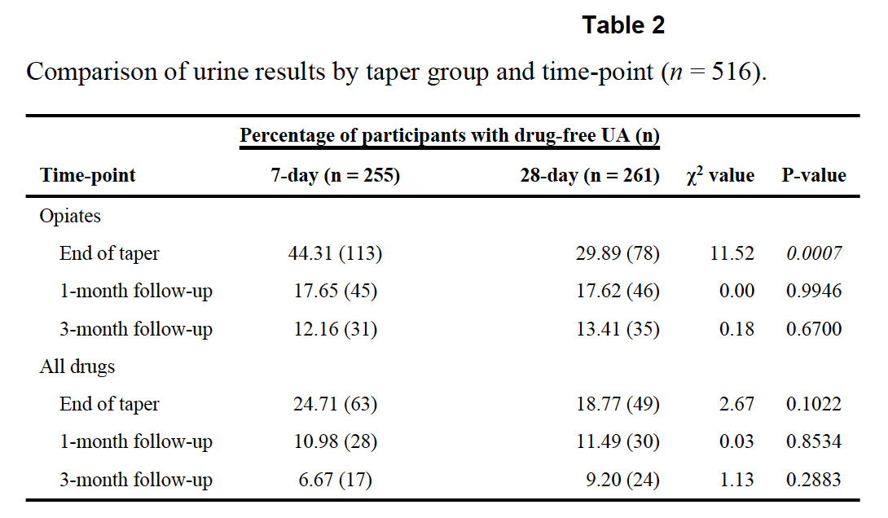
Ling 2009

Slide 18
Woody 2008
100%
% opioid positive urine test
0%

Slide 19
Sees et al 2000: MMTP v 180 day detox

Slide 20
Sees 2000: MMTP v 180 day detox
Detox off of methadone
Continue use of methadone

Slide 21
Fiellin 2014: Bup taper v maintenance

Slide 22
Warden et al 2012 (youth)

Slide 23
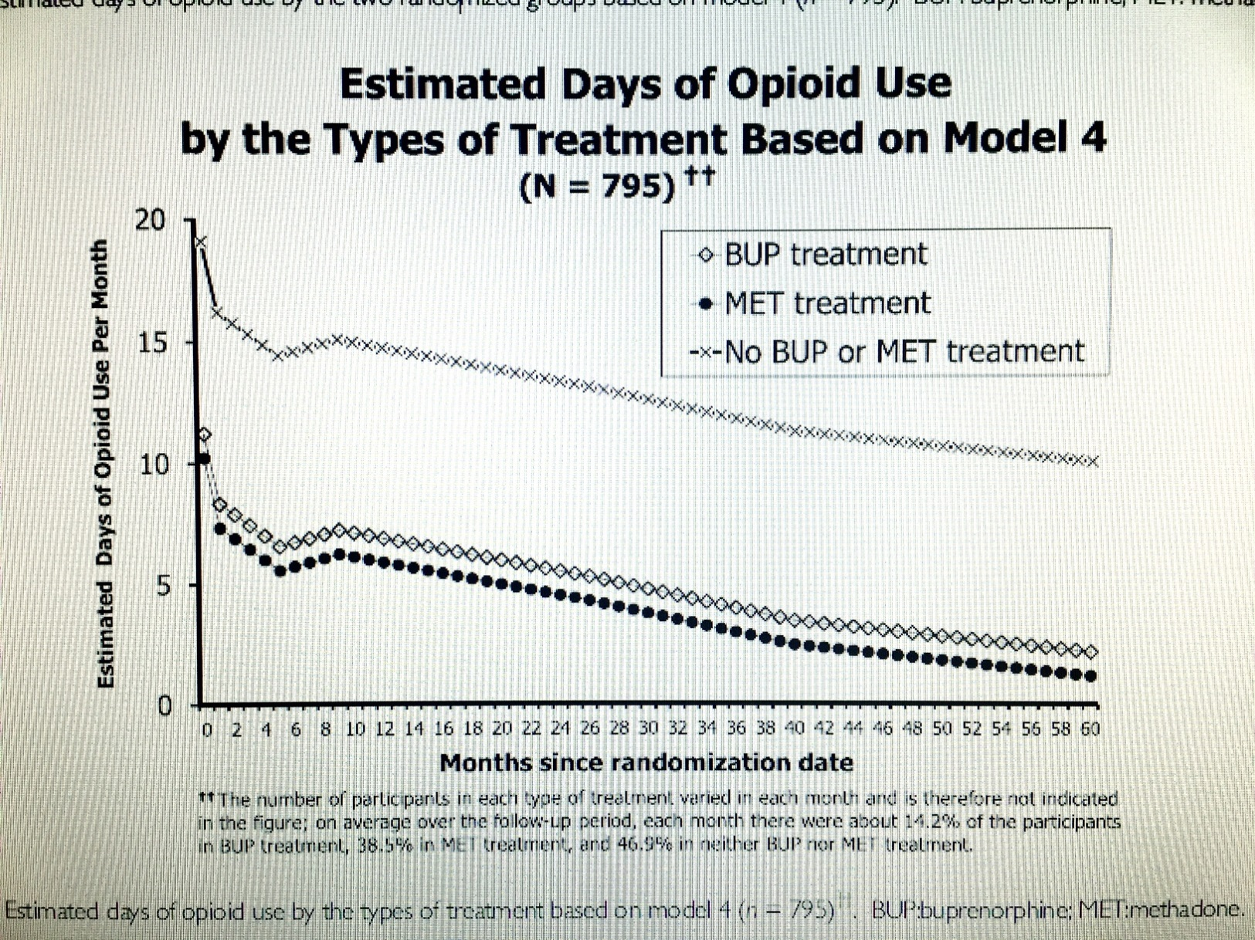
Hser et al 2015 (START study)
1
2

Slide 24
Predictors of Retention
Not demographics alone
Age of initiation
  Sometimes correlated with age of presentation to treatment
Addiction history severity
  Length of severity (i.e. heroin use, injection history)
  Premorbid functioning

Slide 25
Anticipatory Guidance
Patients need advice on:
      Getting through detox period successfully
      Symptoms following induction on MAT
      Necessary duration of treatment (i.e. 12+mo)
        What will get in their way? Internal beliefs?
What systems of care are needed to shepherd through this process successfully?

Slide 26
Resources
Providers’ Clinical Support System (PCSS)
  PCSS-MAT: http://pcssmat.org

Slide 27
Tapering

Slide 28
Tapering
Typically patients with continuous sobriety for 1-2+ years have the best outcomes
  Treatment <6 months has worse outcomes
There is no evidence to support stopping MAT
  95% of methadone patients do not achieve abstinence when attempting to taper off (Nosyk, et al. 2013)
  Over 90% of buprenorphine patients relapse within 8 weeks of taper completion (Weiss, et al. 2011)
Successful patients are commonly maintained on
  Methadone for 24+ months, Buprenorphine for 18+ months

Slide 29
References
  Bentzley BS, Barth KS, Back SE, Book SW (2015). Discontinuation of buprenorphine maintenance therapy: Perspectives and outcomes. J Sub Abuse Treat,52:48-57.
  Fiellin DA, Schottenfeld RS, Cutter CJ, et al (2014). Primary Care–Based Bup Taper vs Maintenance Therapy for Prescription Opioid Dependence: A Randomized Clinical Trial. JAMA Intern Med;174(12):1947-1954.
  Hser Y, Evans E, Huang D, et al (2015). Long-term outcomes after randomization to buprenorphine/naloxone versus methadone in a multi-site trial. Addiction;111:695-705.
  Ling W, Hillhouse M, Domier C, et al. Buprenorphine tapering schedule and illicit opioid use. Addiction. 2009;104(2):256-265.
  Nosyk B, Anglin D, Brissette S, et al (2013). A call for evidence-based medical treatment of opioid dependence in the United States and Canada. Health Affairs; 32(8)1462-1469.
  Sees KL, Delucchi KL, Masson C, et a (2000)l. Methadone maintenance v 180 day psychosocially enriched detoxification for treatment of opioid dependence. JAMA 283(10):1303-1310
  Sigmon, S. C., Dunn, K. E., Saulsgiver, K, et al. (2013). A randomized, double-blind evaluation of buprenorphine taper duration in primary prescription opioid abusers. JAMA Psychiatry.
  Warden D, Subramaniam GA, Carmody T, et al (2012). Predictors of attrition with buprenorphine/naloxone treatment in opioid dependent youth. Addictive Behaviors 37:1046–1053.
  Weiss RD, Potter JS, Fiellin D, et al. A Two-Phase Randomized Controlled Trial of Adjunctive Counseling during Brief and Extended Buprenorphine-Naloxone Treatment for Prescription Opioid Dependence. Arch Gen Psychiatry. 2011;68(12):1238–46.
  Woody GE, Poole SA, Subramaniam G, et al. Extended vs short-term buprenorphine-naloxone for treatment of opioid-addicted youth: a randomized trial. JAMA. 2008;300(17):2003-2011.

Slide 30
Thank you
If you have any questions/comments, please contact:
Nick Szubiak, Integrated Health Consultant at the National Council for Behavioral Health
NickS@thenationalcouncil.org

