Slide 1
Many Pathways to Recovery

Slide 2
Objectives
State 3 reasons a person’s pathway in recovery is unique;
Recognize 2 mutual aid supports available to people in recovery; and
Recall at least 3 pathways to recovery discussed in this material
Review up to 5 different recovery supports

Slide 3
Many Pathways
Is one of the most controversial of our time
What makes that so?
  Challenges our routine
  Challenges our beliefs
  Challenges our own recovery

Slide 4

Ask Yourself…
What do I consider the “right” way to recover?
How often do I direct people seeking or in recovery down the same path I have traveled?
Do I think in terms of black and white when it comes to the correct recovery pathway?
Do I allow room for medication-assisted recovery to fall into my view of recovery?

Slide 5


Slide 6
When discussing the idea of different pathways to and in recovery, what works for one person may or may not work for another.
This may combat the old sayings, “a drug is a drug is a drug” or “you are not unique”
Based on a qualitative research study funded by the Center for Substance Abuse Treatment (CSAT) people with sustained recovery report using a myriad of pathways.
View the PDF, Pathways to Healing and Recovery: Perspectives from Individuals with Histories of Alcohol and Other Drug Problems for the entire study.

Slide 7

Clinical Services
Detoxification
Residential (not inpatient)
Outpatient
Individual counseling
Individual therapy (Masters level and above)

Slide 8

Non-Clinical Services
Sober Homes
Peer Support

Slide 9
Natural Recovery
Some people stop using with no interventions

Slide 10
Bodywork
Bodywork is most often used by people in recovery to assist with meditation and deeper thinking.
Examples of bodywork might include:
  Energy work and Energy Healing such as Acupuncture, Acupressure, Chakra Healing, Reflexology, Reiki, and Smudging. Counselors in Texas are eligible to complete training and certification for Acudetox, which is similar to Acupuncture, focusing solely on decreasing detoxification symptoms;
  Massage;
  Traditional Chinese Medicine; and
  Yoga

Slide 11
Mutual Aid
Once called “self-help”
To 12-step or not to 12-step? – That is the client’s decision
When choosing treatment or support services, there are many options. A first-time consumer may not know what to look for. A helping professional can guide people to make the best decisions by being as informed as possible.
On their website, Recovery.org describes the differences between 12-Step programs and non-12 Step programs

Slide 12
Some of the more available
AA
NA
Celebrate Recovery
Refuge Recovery
SMART Recovery

Slide 13
Faith Based Mutual Aid
Addictions Victorious is a non-denominational recovery program with focus on Christ. This program is not yet available in Texas.
Alcoholic’s Victorious is a 12-step program for people in recovery who recognize “Jesus Christ as their Higher Power”.
Alcoholics for Christ is Jesus-centered and provides support for those with addiction who are seeking recovery, family members of people with addiction, and those who are now adults who grew up in homes with addiction.
Buddhist Recovery Network (2008) focused on recovery through use of Buddhist principles, mindfulness, and meditation.
The Calix Society is described as, “Calix is an association of Catholic alcoholics who are maintaining their sobriety through affiliation with and participation in the Fellowship of Alcoholics Anonymous”.
Celebrate Recovery (CR) (Founded in 1990) is a 12-step program that originated from Saddle Back Church in California. CR supports people in recovery from any addiction, including process disorders. A person working this program will identify himself or herself as a believer of Christ who is struggling with an addiction, rather than by the addiction alone.

Slide 14
Christians for Recovery engages in active discussions based on the bible.
Jewish Alcoholics, Chemically Dependent Persons and Significant Others (JACS) is a recovery community for Jewish people in recovery.
Millati Islami is a 12-step program based on Islamic principles and in accordance to the Islamic way of life.
Life Recovery groups
Overcomers Outreach is a 12-step program based on scripture. Addressed in Overcomers are mental health, addiction, and other difficulties.
RU Recovery is biblically based on Christian recovery and has chapters already established in Texas.
The National Association for Christian Recovery is not a recovery program but a referral source for Christian based recovery meetings. Their website has an extensive list of options.

Slide 15
Secular Recovery Supports
AA Agnostica designed for those “disturbed by the religious content in AA meetings”.
Life Ring Secular Recovery emphases “human effort rather than divine intervention”.
Refuge Recovery is a mindfulness practice based on Buddhist philosophy.
Secular AA’s website describes their program: “We are an International Organisation that supports the Agnostic, Atheist and Freethinker in AA. Our purpose is to stay sober and help other alcoholics achieve sobriety, to widen the gateway to recovery, and to help make AA ever more inclusive.”
Secular Organizations for Sobriety has guidelines, rather than structure and focuses on personal responsibility.
SMART Recovery is increasing in availability. Based on Cognitive-Behavioral Theory, SMART Recovery’s website specifies they are “not a spin-off of AA”. The program can help a participant gain awareness and change behaviors. This mutual aid program does not ask members to introduce themselves as “addict” or “alcoholic”.
Women for Sobriety focuses on the specific needs unique to women.
16-Step Empowerment groups have online resources and groups either meeting or currently being created in Texas.

Slide 16
Cultural Needs in Recovery
Examples of cultural ceremonies that may support a person’s recovery today could include:
  Native American Sweat Lodges;
  Chinese Medicine; and
  White Bison Wellbriety

Slide 17
Recovery Schools
College or Recovery?
There are now options for people in recovery to continue recovery while attending college. Collegiate Recovery Programs (CRP) began at Brown University in 1977. Texas Tech began the first CRP in Texas in 1986. The University of North Texas (UNT) has the first fully integrated behavioral health CRP in the country. The CRP at UNT offers daily meetings, course credit for seminar attendance, intermural sports teams, case management, peer recovery coaching, employment opportunities, travel, service opportunities, and recovery housing on campus.

Slide 18
If you are thinking of starting a CRP, contact the Association of Recovery in Higher Education (AHRE). The organization offers resources and assistance.
Executive Producer, Greg Williams explores the largest sober high school in the world – located in Houston, Texas – in his documentary Generation Found.
Sarah Nerad is one of the founding members of Young People in Recovery (YPR) and is well known in the Recovery Schools arena. She shared about her CRP experience in this Ted Talk.

Slide 19
Teletherapy
Who is in favor?
Who is opposed?
Positive option for
  People in rural areas
  People who travel a great deal
  People with limited mobility or
  Conditions causing isolation to home

Slide 20


Slide 21



There is an app for that!
Here are only three. There are more in the RTP Curriculum
Sober Grid
Counts time
in recovery
NA Just for Today
Readings and Meditations
Mind Shift
Help for Anxiety

Slide 22
Documentaries
In 2007 HBO made this 1 hour and 30minute film. Addiction The documentary is broken into the following nine segments:
  Saturday Night in a Dallas ER
  A Mother’s Desperation
  The Science of Relapse
  The Adolescent Addict
  Brain Imaging
  Opiate Addiction: A New Medication
  Topiramate: A Clinical Trial for Alcoholism
  Steamfitters Local Union 638
  Insurance Woes

Slide 23

Music
Elton John, Eric Clapton, Anthony Keidis, Eminem, and Justin Furstenfeld - to name a few - are open about their journey in recovery.
Joseph visited the Dallas Chapter of TAAP in January 2018 to present: Music is Medicine: Incorporating music into clinical practice!

Slide 24

Recovery Comedy is comprised of comedians in recovery performing standup related to addiction and recovery. In this troupe there are 18 comedians.
Entertainers who are open about their recovery not only provide people in recovery enjoyment through their art, they are also in a position to help decrease stigma.

Slide 25


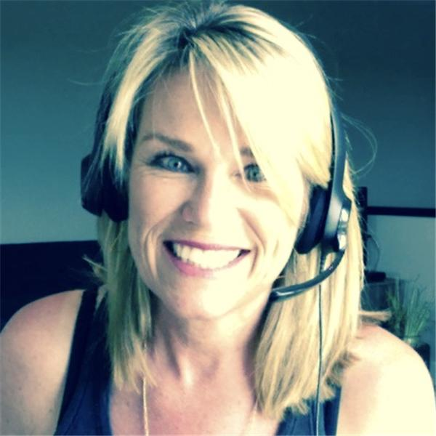
The Bubble Hour is hosted by a stigma-breaking woman in recovery
Bad Story explores addiction and mental health recovery

Slide 26
Conferences
Recovery Conferences
Addiction Professional Conferences
AA/NA Conventions
Refuge Recovery annual Conference

Slide 27
Social Media
There are many social media platforms to support every type of recovery that exits.
  Treatment centers using social media private rooms to keep their alumni connected.
  Juggling the Jenkins is a blog and Facebook page run by a woman who talks about the struggles she has experienced.
  Review the blog entry through the Minnesota Recovery Connection, Social Media and Recovery: The New Frontier

Slide 28
Personal Recovery Supports
Things that support recovery are sometimes right around the corner:
  Personal Development books and workbooks;
  Life Enrichment Seminars and Workshops;
  Classes at Church;
  Art class;
  Riding horses;
  Medication assisted recovery; and
  Cooking classes.

Slide 29
An All-Inclusive Support
For professionals
People in Recovery
Family members
Students
Others interested
Created for professionals, peers, students, family members, and anyone interested UNT RTP Community of Practice on Facebook.

