Slide 1
SOGIE
Developed by Paula Heller Garland
for The University of North Texas
© 2018

Slide 2
Recovery and the LGBTQ/SOGIE Community
SOGIE – Sexual Orientation, Gender Identity and Expression –
Has grown beyond traditional acronyms to include everyone and how they identify. Better at describing inclusion of all people.
Describes who were are, who we have relationships with, how we identify and express ourselves
LGBTQIA – Lesbian, Gay, Bisexual, Transgender, Queer, Intersex, Ally
Traditional acronym that has historically been used to identify the queer community and those that support them
Both are determined by the individual, regardless of birth or family/societal/cultural expectations

Slide 3
How it All Fits
Sex, gender and orientation are all different.
They are determined according to how an individual identifies themselves, regardless of familial, social or cultural expectations.

Slide 4
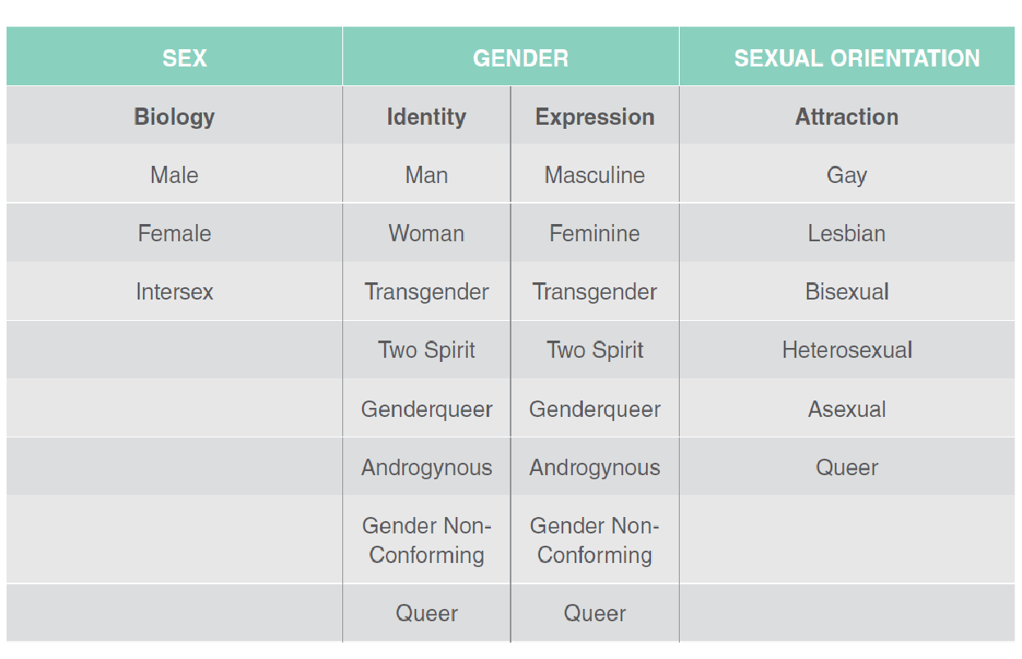
How it All Fits

Slide 5
Terms
Ally: Describes a person who confronts and challenges heterosexism, sexism, homophobia, transphobia, and heterosexual privilege in herself or himself and others.
Androgyny: A self-ascribed state of embodiment among individuals rejecting the binary structure of woman and man.
Asexual: Asexuality is the lack of sexual attraction to others, or low or absent interest in or desire for sexual activity. It may be considered the lack of a sexual orientation, or one of the variations thereof, alongside heterosexuality, homosexuality and bisexuality. Romantic relationship can be referred to as hetero, homo, bi or a/romantic.
Bisexual: Describes a person who is attracted to both men and women.

Slide 6
Terms
Cisgender: Describes a person whose gender identity matches his or her sex assigned at birth.
Coming Out: Describes the act or process of voluntarily disclosing one’s sexual orientation or gender identity.
Gay: Describes a person who is attracted to individuals of the same gender. While historically used to refer specifically to men, it is often used to refer to women attracted to other women, as well.
Gender: A social construct used to classify a person as a man, woman, or some other identity. Fundamentally different from the sex assigned at birth, it is often closely related to the role that a person plays or is expected to play in society Gender binary: The idea that there are only two genders-male/female or man/woman and that a person must be strictly gendered as either/or.
Genderqueer: A gender variant person whose gender identity is neither male nor female, is between or beyond genders, or is some combination of genders. Often includes a political agenda to challenge gender stereotypes and the gender binary system.

Slide 7
Terms
Gender Non-Conforming (GNC): Describes a person who does not subscribe to gender expression or roles imposed by society. Similar terms include: gender creative, genderfluid, gender variant, genderqueer, and pangender. One example would be a girl or woman who, in the past, may have been referred to as a “tomboy.”
Heterosexuality: Describes a sexual orientation in which a person feels physically and emotionally attracted to individuals of the opposite sex.
Homophobia: The irrational hatred and fear of lesbian or gay people, or disapproval of other sexual orientations, regardless of motive. Homophobia includes prejudice, intolerance, discrimination, harassment, and acts of violence against people on the basis of their gay or lesbian identity. It occurs on personal, institutional, and societal levels, and is closely linked with transphobia and biphobia. Internalized homophobia is the fear and self-hate of one’s own gay or lesbian identity, which can occur for individuals who have been conditioned throughout childhood with negative ideas about sexual orientations other than heterosexuality.
Intersex: Describes a set of medical conditions that feature congenital anomaly of the reproductive and sexual system. That is, intersex people are born with sex chromosomes, external genitalia, or internal reproductive systems that are not considered “typical” for either males or females. [Note: Hermaphrodite is an offensive and out-of-date term for an intersex person.]

Slide 8
Terms
“In the Closet”: Refers to a lesbian, gay, bisexual, transgender, or intersex person who chooses not to disclose his or her sex, sexual orientation, or gender identity to friends, family, co-workers, or society. There are varying degrees of being “in the closet.” For example, a person can be “out” in his or her social life, but “in the closet” at work or with family. Also known as “Down-low” or “D/L.”
Polyamorous: Refers to relationships with multiple partners and can include: open relationships, polyfidelity (which involves multiple romantic relationships with sexual contact restricted to those), and sub relationships (which denote distinguishing between a “primary” relationship or relationships and various “secondary” relationships).
Queer: An umbrella term used to refer to all LGBT people; the term can be a political statement as well as an identity, seeking to expand upon limited sexual and gender-based categories. For some, “queer” has a negative connotation, given its historical use as a pejorative term. Many LGBT people, however, have reclaimed the word and now use it in a positive light. Many people use the term “queer” because other terms do not accurately describe them.

Slide 9
Terms
Questioning: People who are unsure of, or in the process of, discovering, their sexual orientation, gender identity, or gender expression.
Sex: Assigned at birth, a biological construct based primarily on physical attributes such as chromosomes, external and internal genital and reproductive anatomy, and hormones.
Sexual Orientation: An attraction to others that is shaped at an early age (usually by about the age of ten). Sexual orientation falls on a spectrum that ranges from attraction to only men or only women, to varying degrees of attraction to both men and women, to attraction to neither men nor women.
Transgender: Describes a person whose gender identity and sex assigned at birth do not match.
Two Spirit: A term used in some Native American communities for persons who identify with gender roles of both men and women, and/or are considered a separate or third gender

